Slide 1

SIDDHARTH INSTITUTE OF ENGINEERING & TECHNOLOGY
(AUTONOMOUS)
(Approved by AICTE, New Delhi & Affiliated to JNTUA, Ananthapuramu)
(Accredited by NBA for Civil, EEE, Mech., ECE & CSE
Accredited by NAAC with ‘A+’ Grade)
Puttur -517583,Tirupathi District, A.P. (India)
DEPARTMENT OF COMPUTER SCIENCE AND ENGINEERING
CSE (ARTIFICIAL INTELLIGENCE)
Academic Year 2025-26
Project Zeroth Review
Title of Project
Towards Green and Trustworthy 6G:Federated Learning Approaches for Robust Privacy
Batch Details
S.NO: | REG NO | NAME | INTERNAL GUIDE
1 | 22F61A3114 | C S MADESH | K EZHILARASI
2 | 22F61A3119 | D MOUNIKA
3 | 23F65A3101 | K ADIMURTHY
4 | 23F65A3106 | T VIJENDRA

Slide 2
OBJECTIVE
The objective of this project is to design and implement a privacy-preserving, decentralized machine learning system tailored specifically for the demanding environment of 6G networks.
With the help of Federated Learning (FL), the system enables multiple edge devices to collaboratively train machine learning models without sharing their raw data, thereby preserving user privacy and reducing network congestion.
The project involves developing a secure and interactive web application using Flask, where users can register, upload beamforming datasets, select from multiple machine learning algorithms, and receive real-time prediction results. The backend simulates FL rounds by averaging encrypted model weight updates from virtual edge clients.
Ultimately, the system demonstrates the feasibility and benefits of Federated Learning for future 6G-enabled intelligent infrastructure.

Slide 3
ABSTRACT
The next generation of wireless communication, 6G, is expected to interconnect billions of ultra‑intelligent devices and deliver sub‑millisecond latency for immersive applications such as holographic telepresence and autonomous mobility.
Traditional cloud‑centric AI pipelines cannot scale to this setting because continuous raw‑data transfer overloads backhaul links and exposes sensitive user information.To address this gap, our project implements a federated‑learning (FL) framework in which edge devices train models locally and share only encrypted weight updates with a coordinating server.
We prototype the concept in a Flask web application that allows users to register, upload sample beamforming datasets, choose among six candidate algorithms (Random Forest, FNN, CNN, MLP, XGBoost, Decision Tree), and receive real‑time prediction feedback on 6G beam‑forming success.

Slide 4
Literature Survey
Sno | Title of the Paper | Year of publication | Author | Comments
1 | Blockchain-empowered Federated Learning for 6G | 2023 | Xu et al. | Combines FL with blockchain for traceability and trust in 6G; emphasizes audit trails and secure updates
2 | Federated Learning for Edge Intelligence in 6G Networks | 2022 | Yang et al. | Overview of enabling FL in 6G, covers latency, non-IID issues, and model convergence
3 | Federated Learning in 6G: A Survey on Enabling Technologies | 2021 | Luong et al. | In-depth survey on FL challenges and architectures in 6G ecosystems
4 | Adaptive Federated Learning in Resource Constrained Edge Systems | 2021 | Wang et al. | Proposes adaptive scheduling strategies to handle client heterogeneity and stragglers

Slide 5
Inferences from Literature Survey
Focus on 6G and Edge Computing:The literature is heavily focused on the application of Federated Learning (FL) within 6G networks and Edge Computing environments (Papers 1, 2, 3, and 4), indicating that this is a current and critical area of research.
Growing Research Interest:The papers span from 2021 to 2023, showing a recent and ongoing surge in research on FL in these next-generation network contexts. The latest paper (2023) focuses on a sophisticated integration, suggesting the field is quickly moving beyond basic application.
Addressing Core Challenges: The surveyed works directly tackle fundamental challenges associated with implementing FL in constrained and advanced networks:
Security and Trust
Resource and Performance Issues

Slide 6
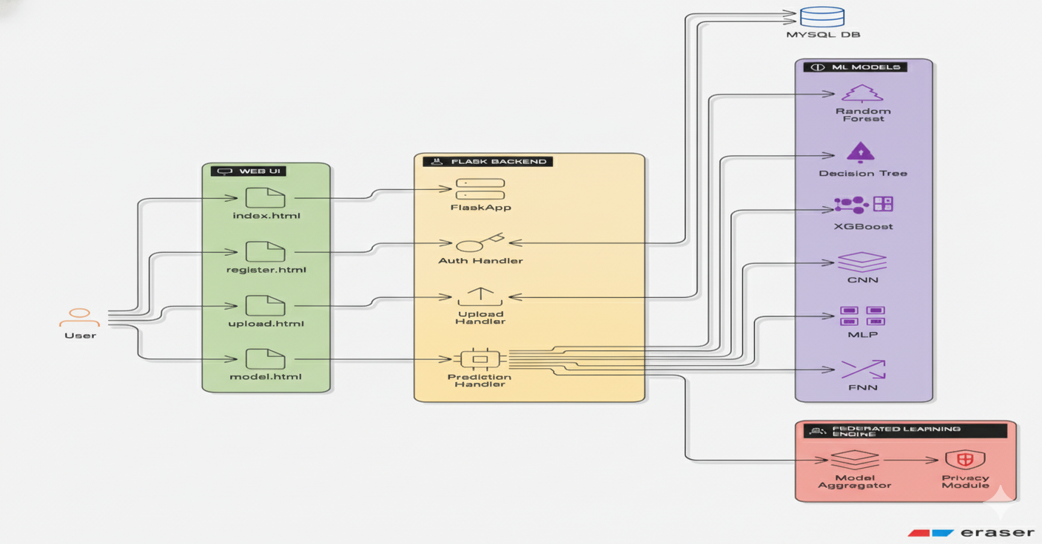
Architectural Diagram

Slide 7
Existing System
🚫Network Overload (Congestion & Delays):
6G devices will generate a huge amount of data in real-time.
Sending all this data to the cloud clogs up the network (called backhaul congestion).
This causes delays, making it bad for things that need instant response, like self-driving cars or holographic calls.
🔒 Privacy and Security Risks:
Sending sensitive user data over the network and storing it in one central place creates major privacy risks.
These systems are also easily attacked by hackers who can poison the training data or reconstruct private information.
🧠 Lack of Adaptability:
These systems don't work well with the distributed and decentralized nature of 6G.
They can't easily provide personalized or local AI updates for individual devices.

Slide 8
Proposed Methodology
The proposed system adopts a Federated Learning (FL) framework tailored for 6G wireless networks.
It decentralizes model training by enabling edge devices to train locally on private beamforming datasets and send only encrypted model updates to a coordinating server. These updates are aggregated to form a global model without exposing raw data.
The system is implemented as a Flask-based web application, allowing users to register, upload datasets, select from six ML algorithms (Random Forest, CNN, MLP, FNN, XGBoost, Decision Tree), and receive beamforming success predictions in real-time.
The back end simulates FL rounds through federated averaging, demonstrating up to 100% accuracy for tree-based models and providing secure, scalable learning without sacrificing data privacy.
The system also benchmarks key benefits such as latency reduction, bandwidth savings, and resistance to gradient inversion attacks. Furthermore, the framework addresses FL challenges like non-IID data, straggler clients, and poisoning attacks, and explores future enhancements using differential privacy, secure aggregation, and blockchain-based audit trails to ensure full trust and traceability in FL-based 6G deployments.

Slide 9
Requirement specification
Hardware
01
(Processor: I5/Intel Processor, RAM: 8GB (min),
Hard Disk: 128 GB, Key Board: Standard Windows Keyboard,
Mouse: Two or Three Button Mouse)
Software
02
Resources
(Operating System: Windows 10, Programming Language: Python 3.10.8, IDE: VS Code)
03
Packages/Libraries
(Streamlit, Sklearn, Transformers, Tensorflow, Pandas, Seaborn, Speech Recognition)

Slide 10
Conclusion
This study demonstrates the efficacy of a machine learning-based framework for early preterm birth prediction using Electrohysterogram (EHG) signals. By combining a custom device with the TPEHGDB dataset and extracting key features like Count Contraction and Entropy, we addressed the critical need for accurate maternal health monitoring. The application of SMOTE-ENN balanced the dataset, while models like Random Forest and Decision Tree achieved superior performance, validated by 10-Fold Cross-Validation. Metrics such as accuracy, precision, and F1-score underscored the robustness of these models. The findings highlight the potential of integrating biomedical signal processing with machine learning to support timely clinical interventions, offering a promising tool to reduce preterm birth complications and enhance neonatal outcomes globally.

Slide 11
THANK YOU

